Slide 1
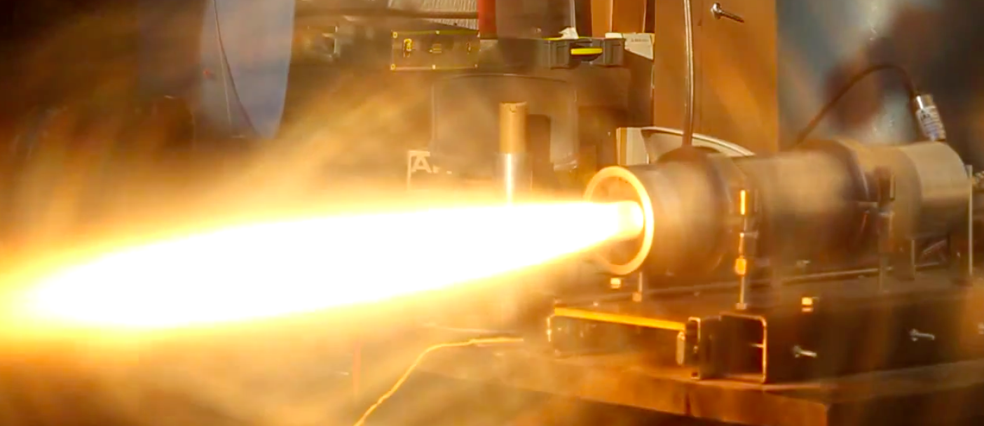

Effects of Swirl Injector Design on Hybrid Rocket Fuel Regression Rate
Testing and Results
Presented by Kyle Bowerman
Team Member, Raul Lugo
Mentor, Matthew Summers

Slide 2
Presentation Summary
Motor Design
Test Setup
Results
Conclusion
Future Endeavors
Questions

Slide 3
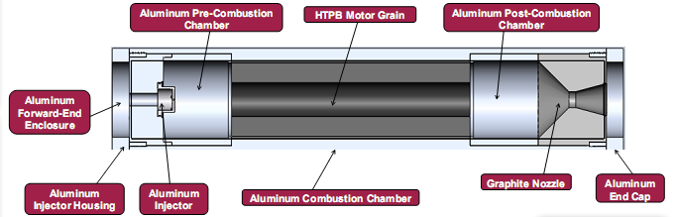
Motor Design
Simplistic Design
Rapid Integration of Components
  Use of Forward and Rear Enclosures
  Easy to Change Injector and Grains

Slide 4
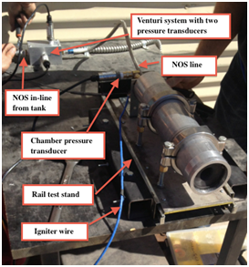
Test Setup
Importance of Safety and Reliability
Nitrous Oxide Tank and Line
Integration of Three Pressure Transducers and Two Load Cells
  Venturi Meter Sytem
  Thrust
  Mass Flow Rate of NOS
Pyrodex Pellet-Bridgewire Igniter
DATAQ DI-718B Data Acquisition System

Slide 5
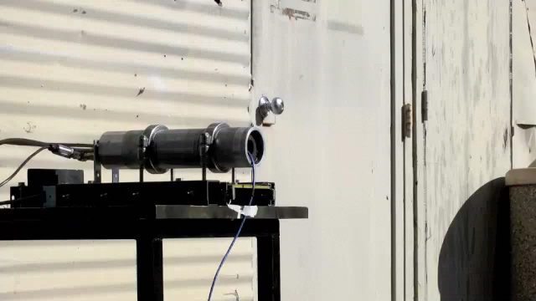
Test Video
60 Degree Injector

Slide 6
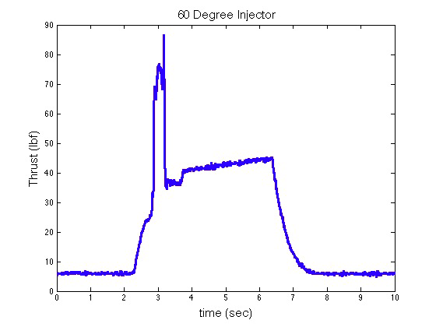
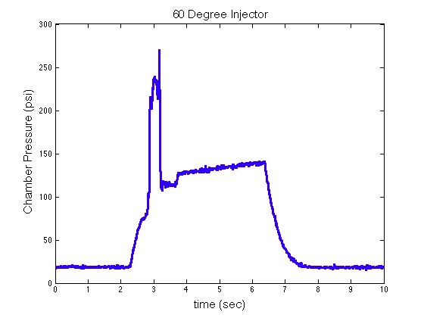
60 Degree Swirl Injector Results
Average Burn Time: 5.12 seconds
Initial Spike Due to Solid Igniter Propellant
Average Thrust of 36.63lbf
Average Chamber Pressure of 114.2 psi

Slide 7
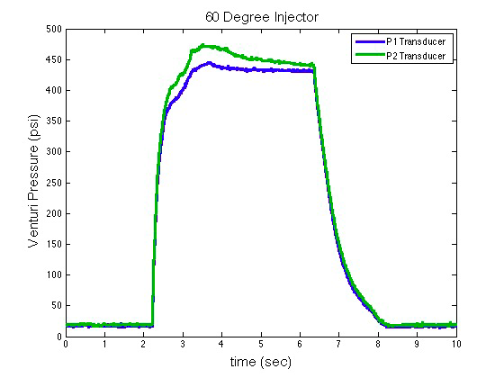
60 Degree Swirl Injector Results
Mass Flow Rate of 0.2370 lb/s
Results for Thrust, Pressure, and Flow Rate Were Lower Than Expected Due to the Oxidizer Tank Nearing Empty After Many Cold-Fire Tests
Regression Rate of Grain Was Calculated to be 0.0314 in/s

Slide 8
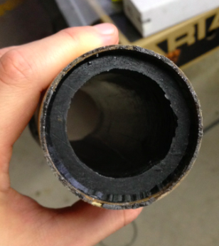
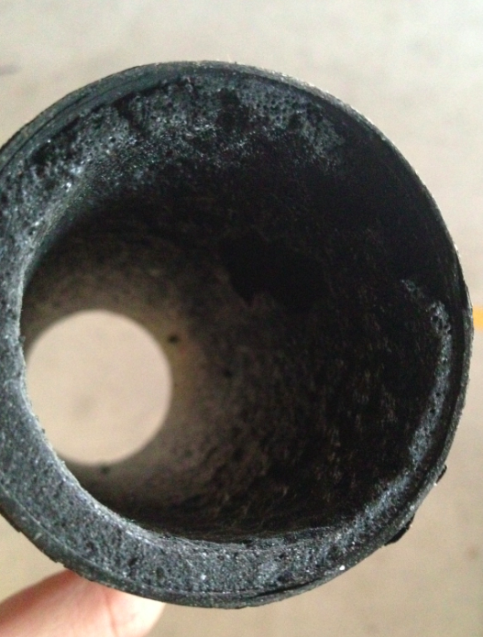
Grain Post and Prior Burn
Prior
Post

Slide 9
Conclusion
& Future Work
The Preliminary Tests on the 60 Degree Injectors Aided in the Understanding and Experience of Conducing Hot Fire Tests
Future Tests Will be Carried Out on Each of the Swirl Injector Designs to Properly Characterize Each Injectors Effect
Oxidizer Mass Flow Rate, Burn Time, and Ignition Events Will be Regulated for Future Tests to Ensure an Improvement of the Accuracy of Data Obtained
Grains Will Undergo Molding From a Foam Based Material to Help Measure the Difference Grain Volume Prior and Post Burn

Slide 10
Special Thanks
ASU NASA Space Grant Consortium
Raytheon Company
Matthew Summers

Slide 11
Thank You!
Questions & Comments

